Slide 1


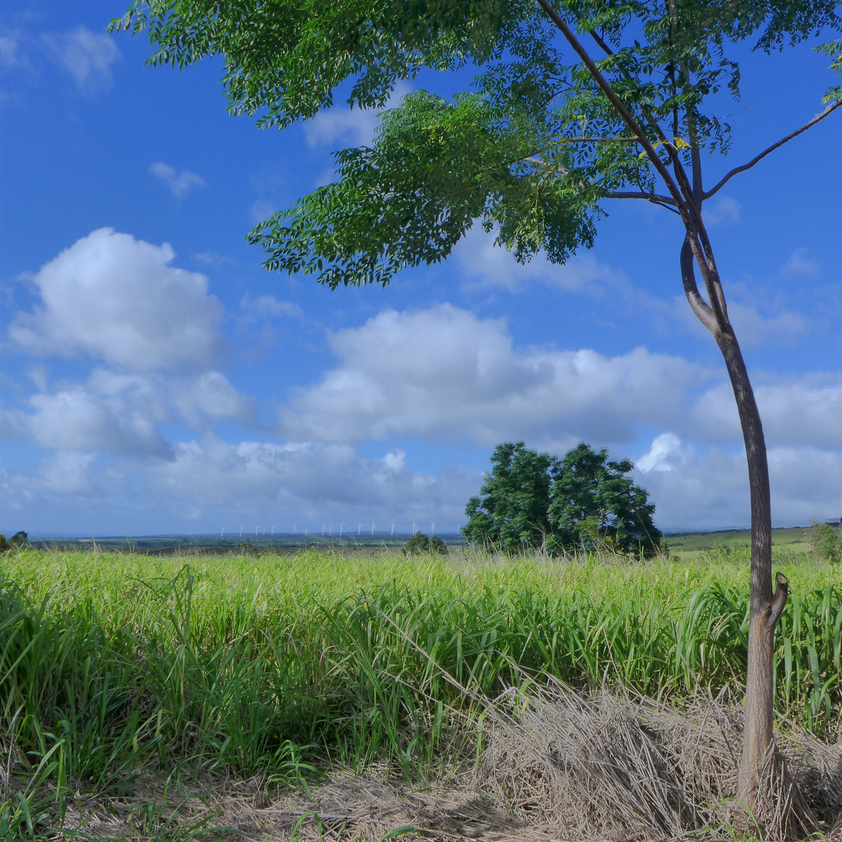
LOGO
Sakyadhita Hawai’i
LOGO
Welcome Mission La’i Peace Center Programs Support Our Work Contact
Notes:
Home page.

Slide 2
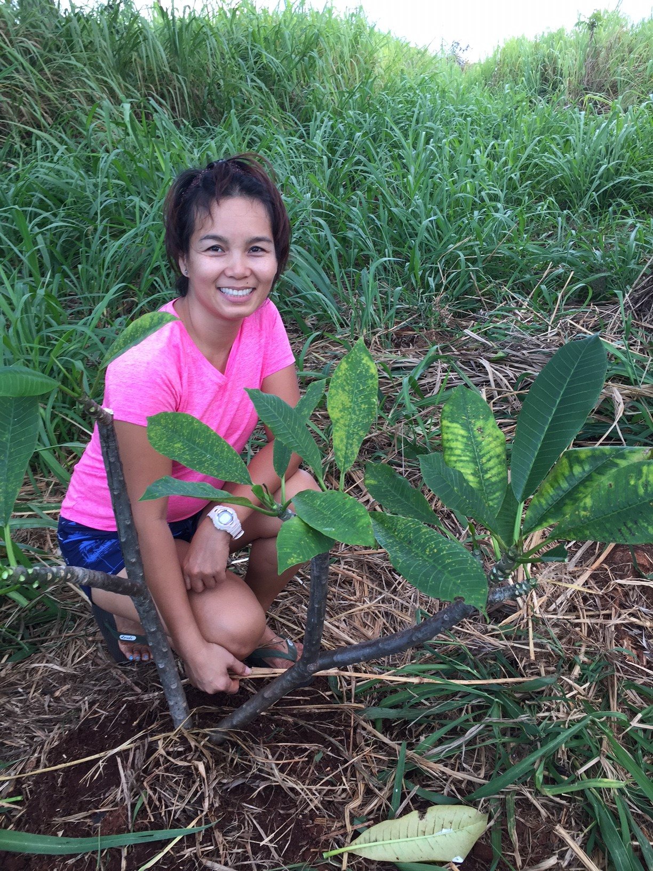
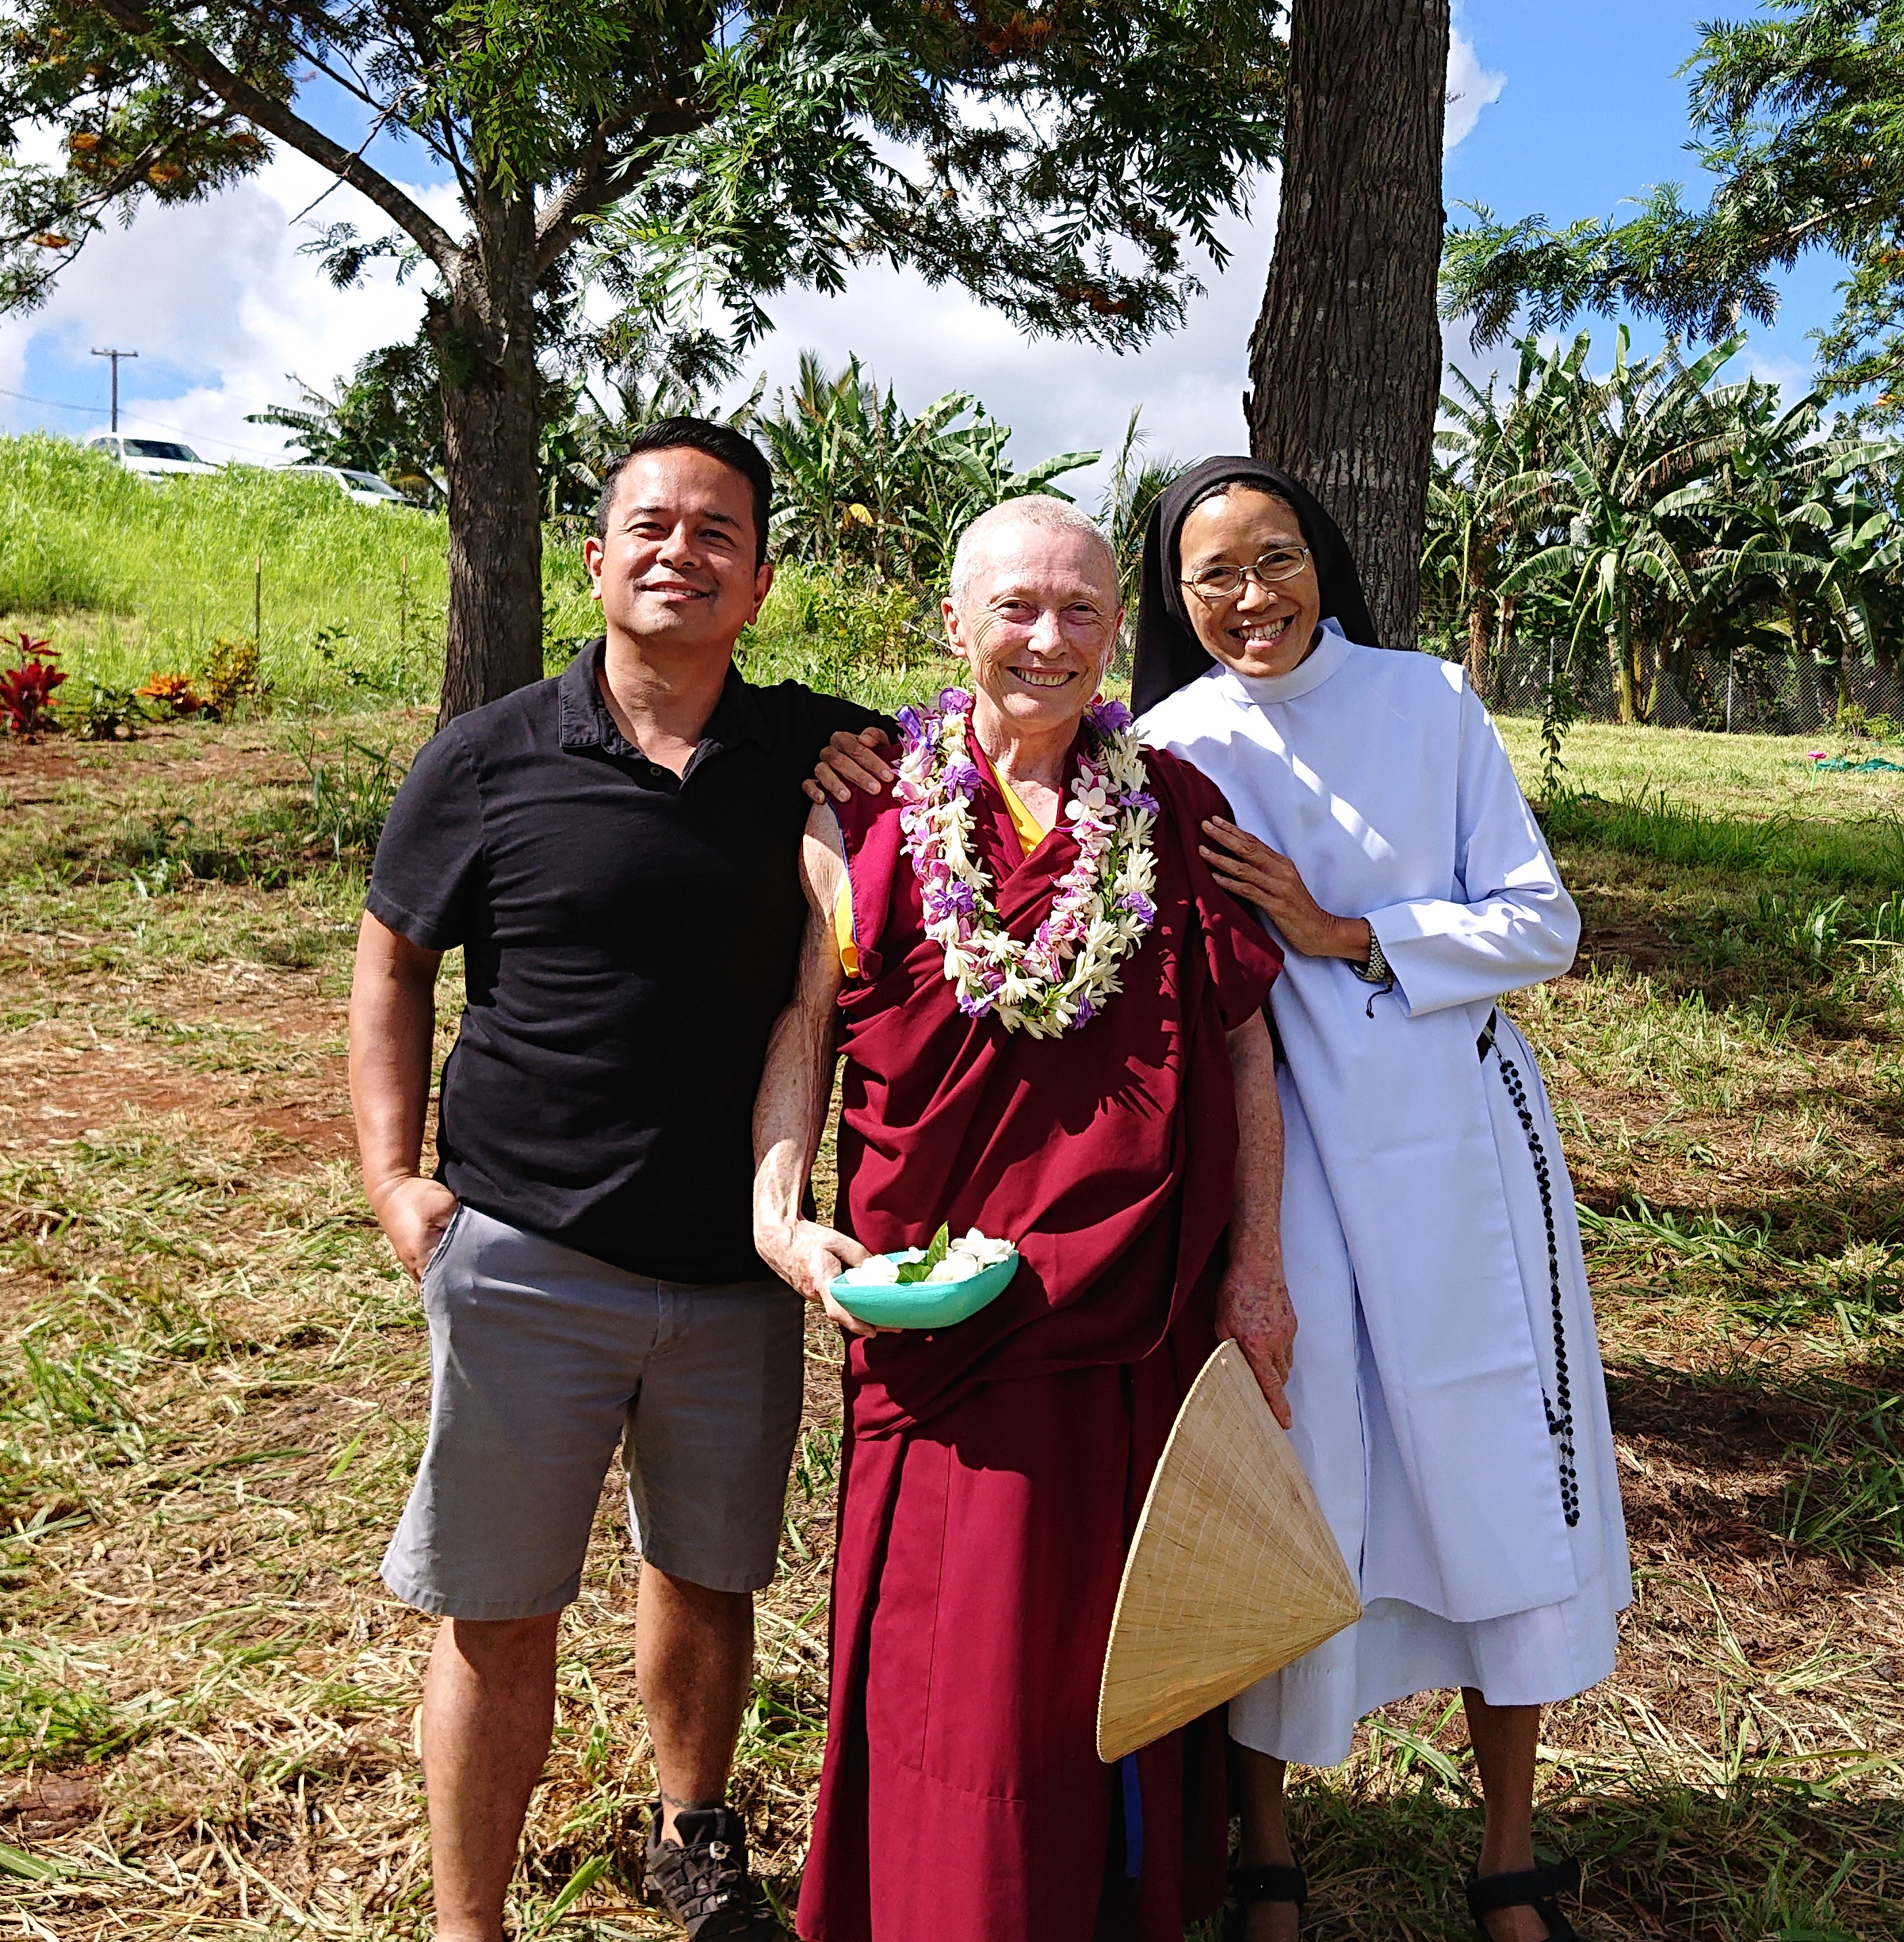
LOGO
Sakyadhita Hawai’i
LOGO
Mission
Notes:
Home page.

Slide 3
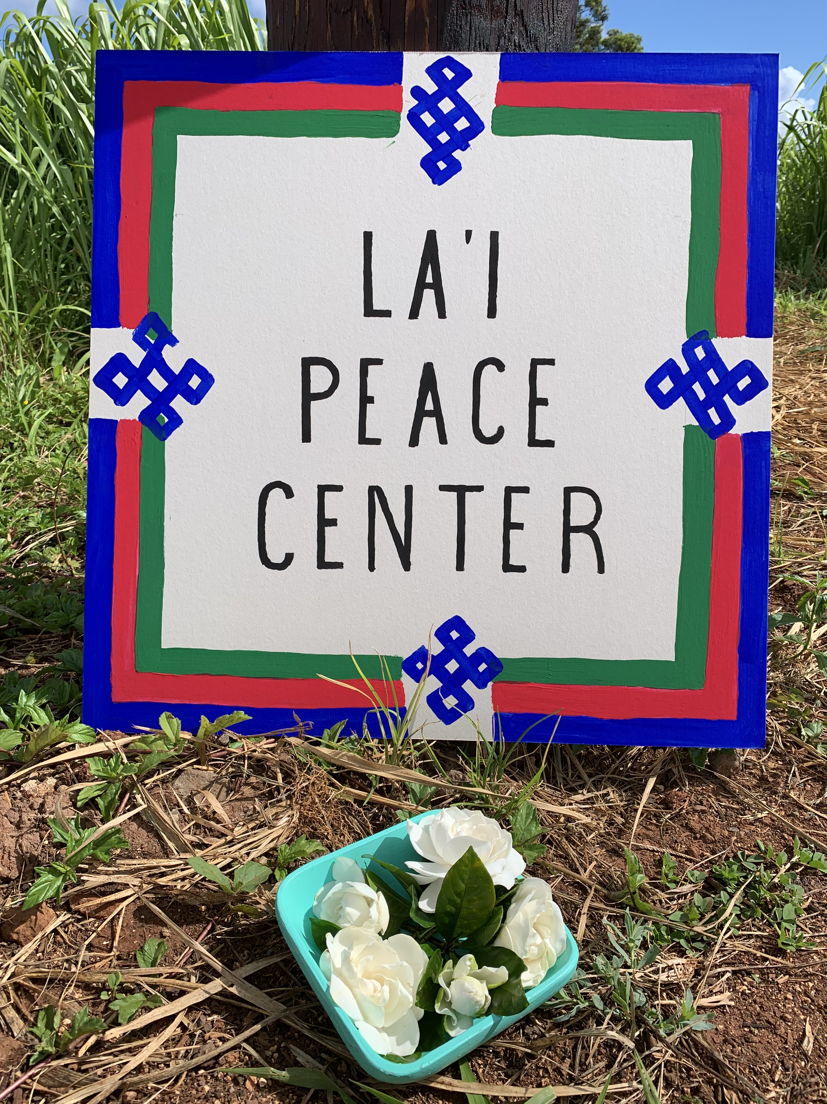
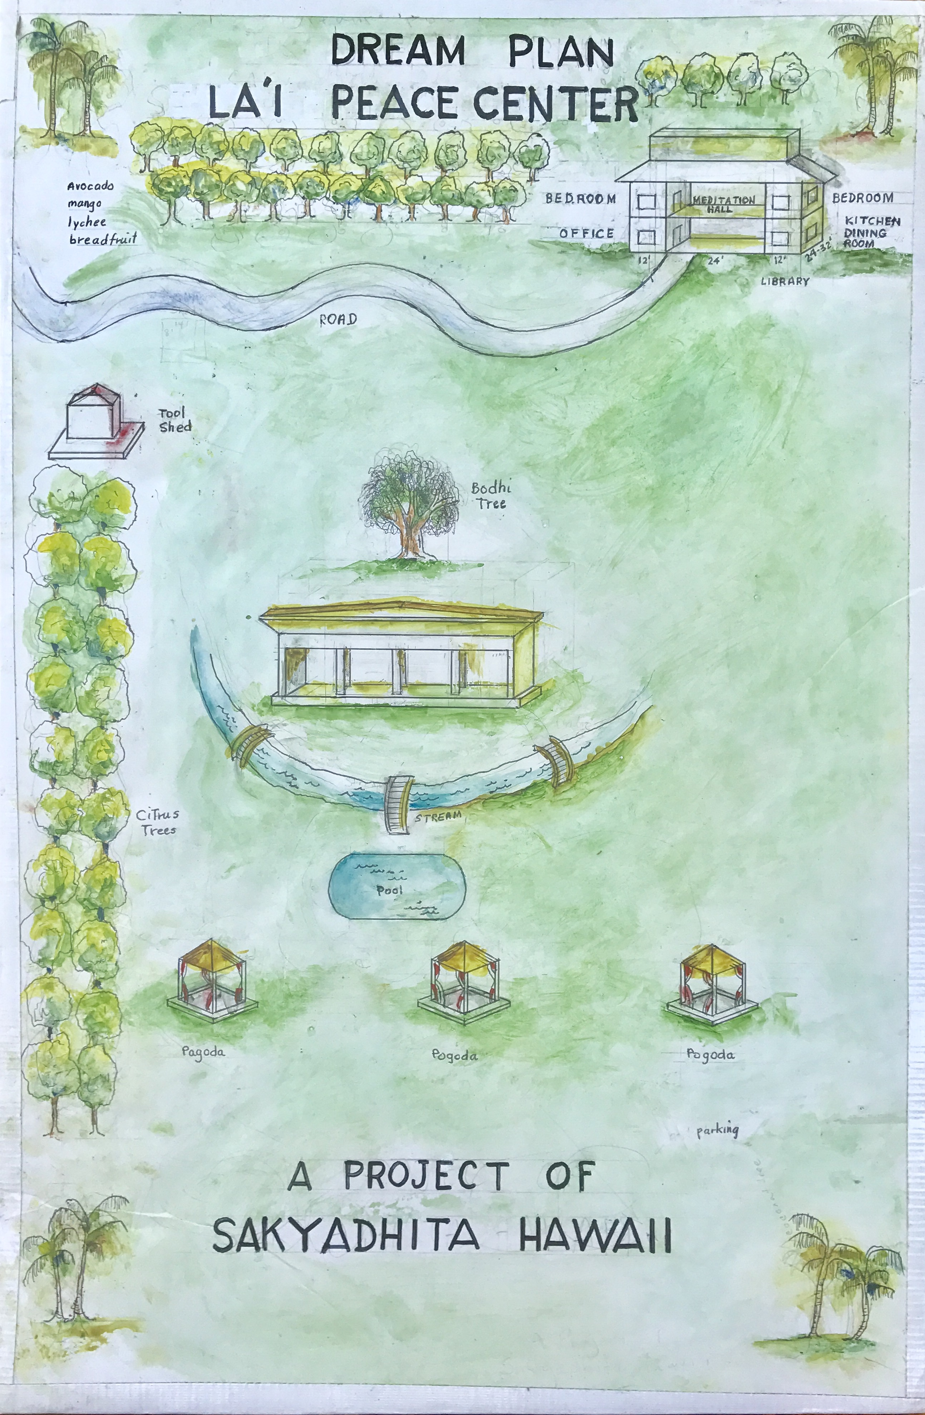
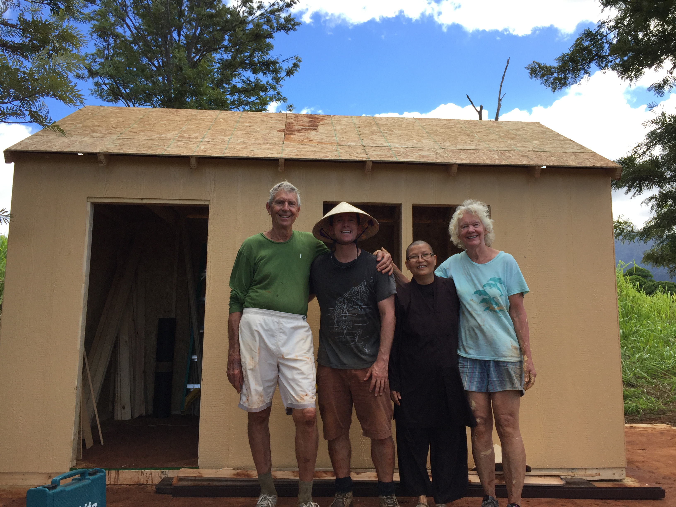
LOGO
Sakyadhita Hawai’i
LOGO
La’i Peace Center
Notes:
Home page.

Slide 4
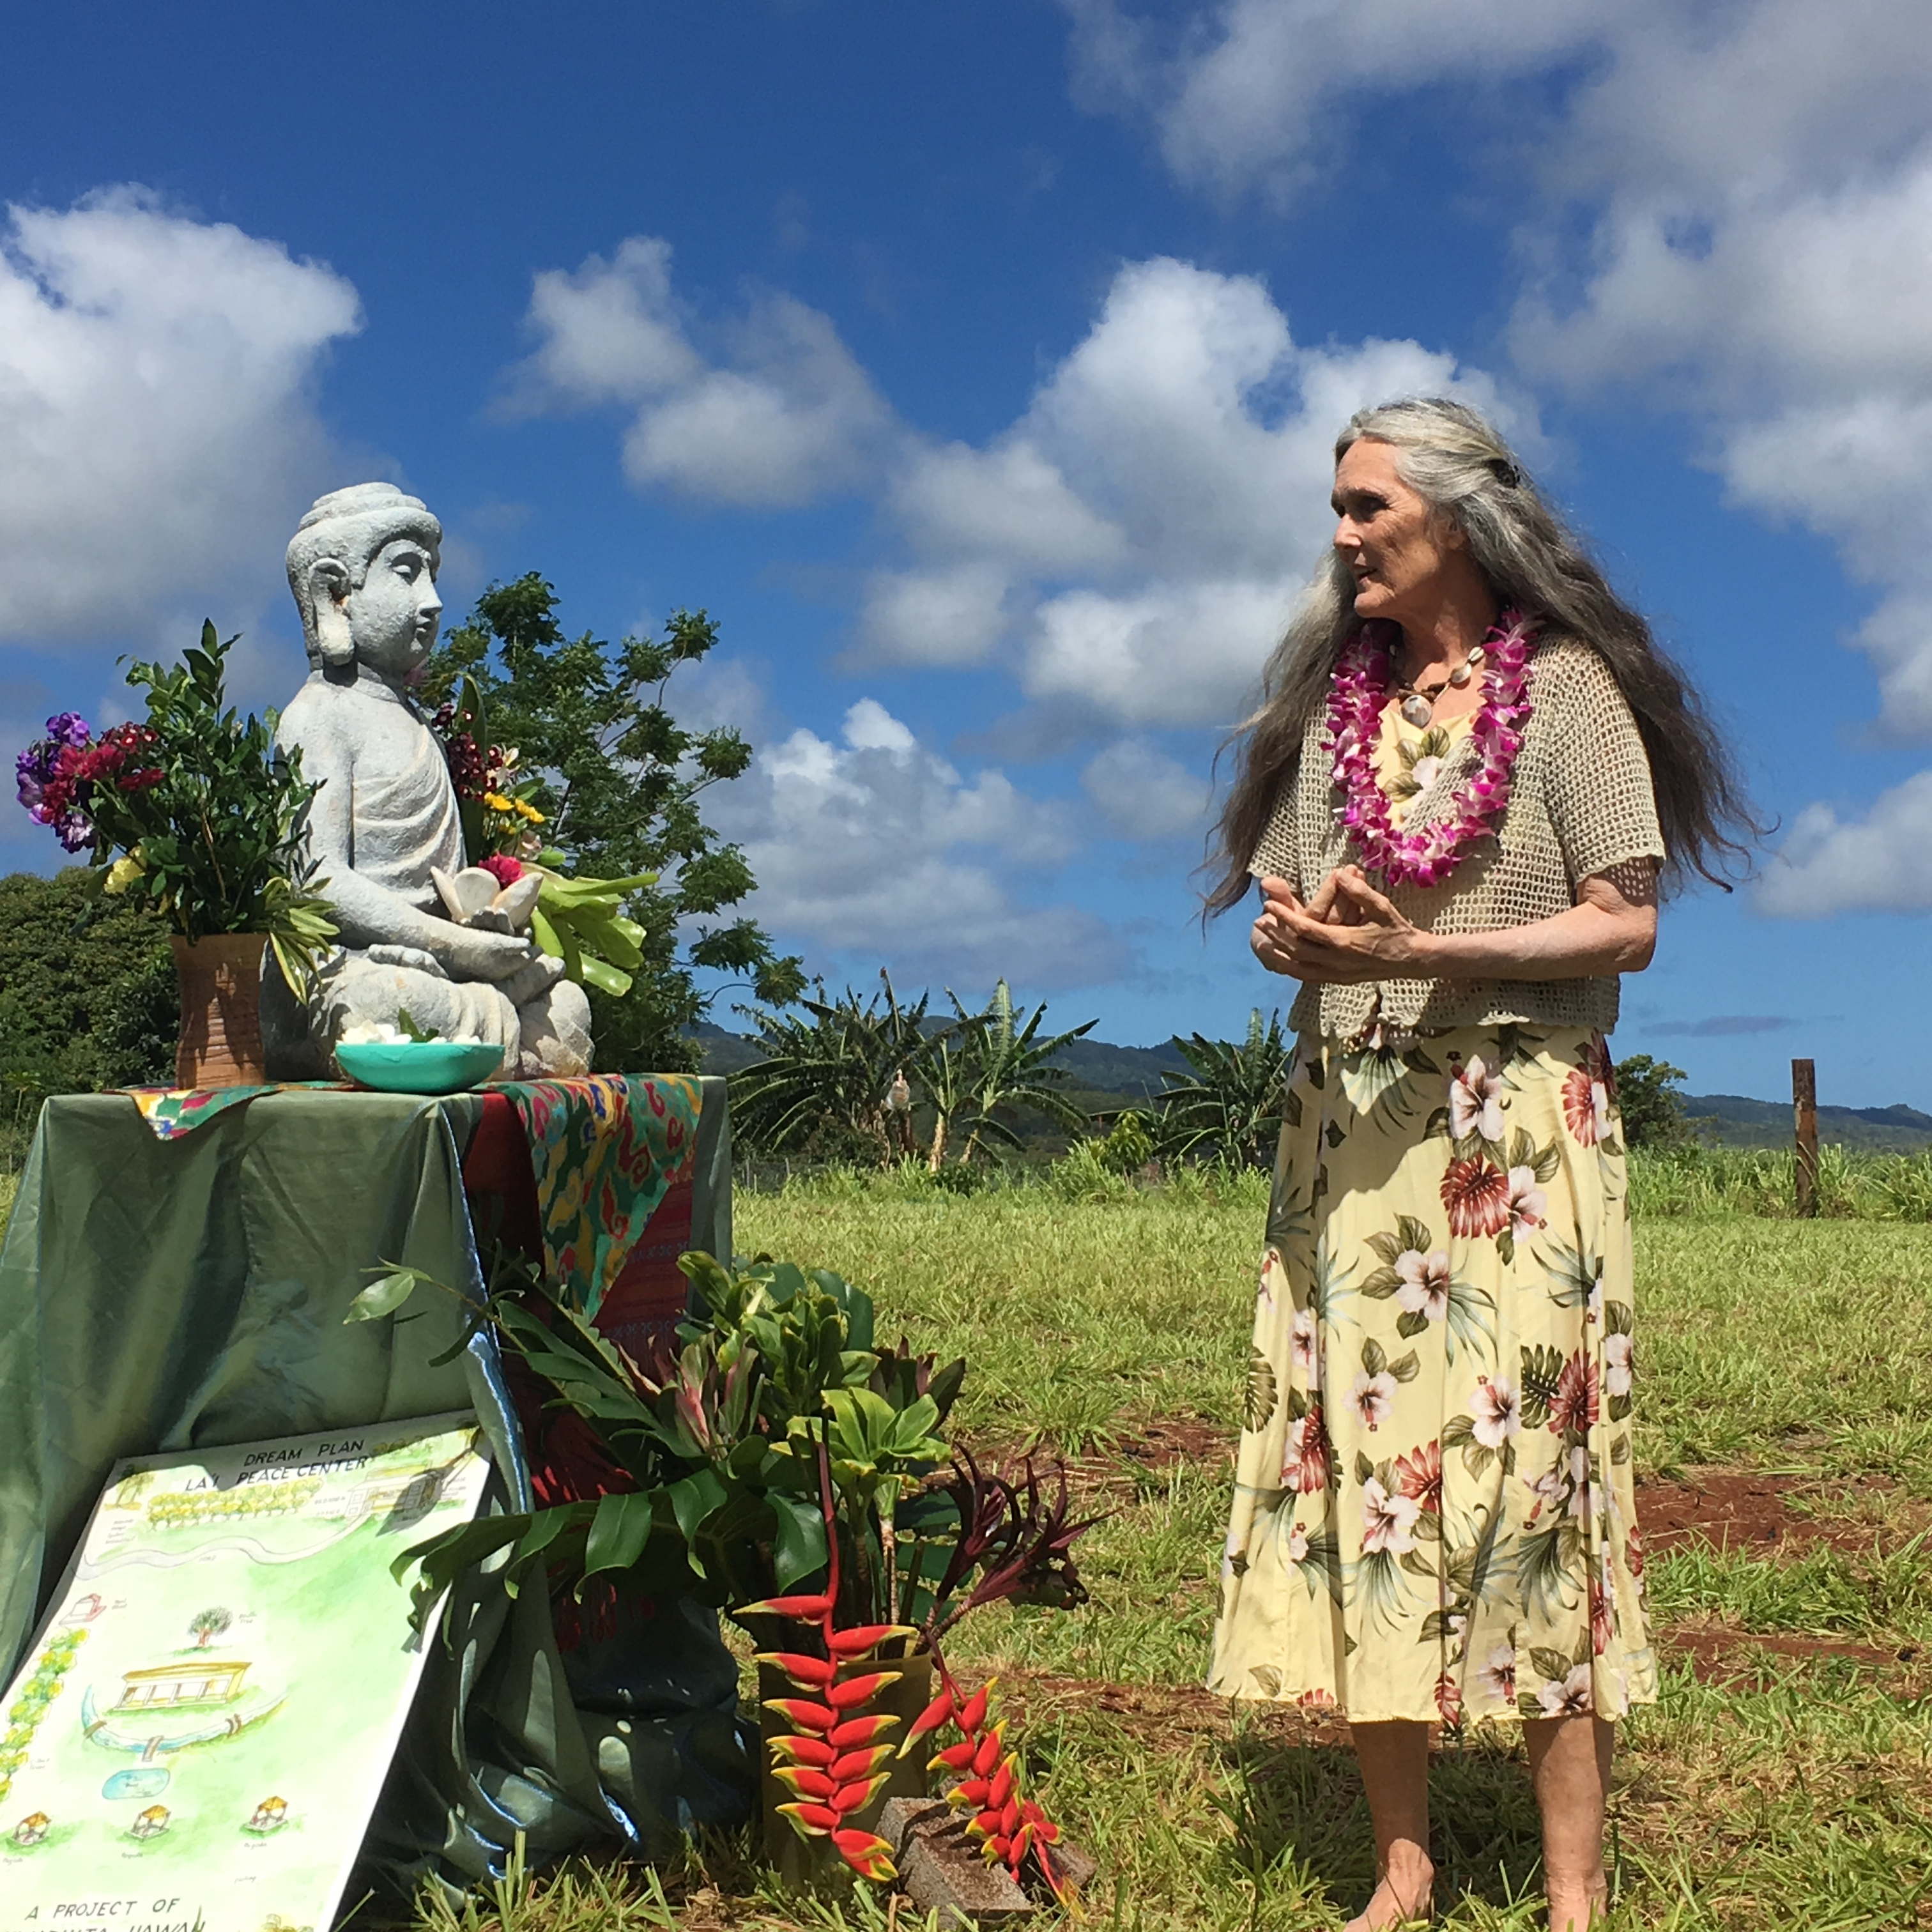
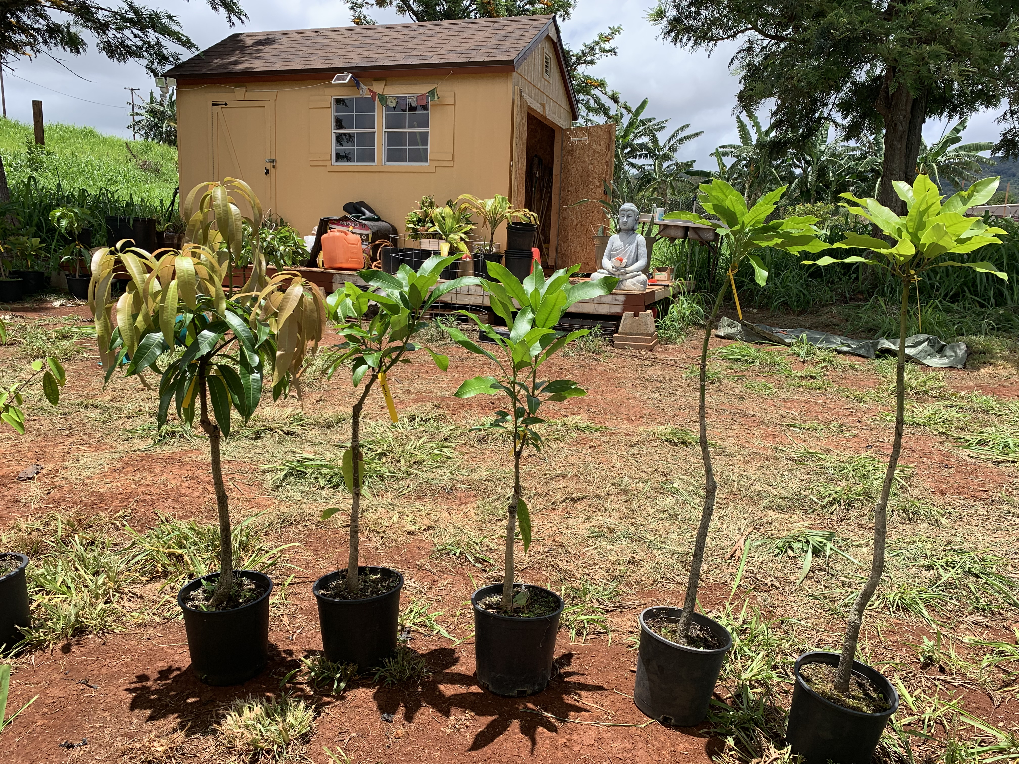
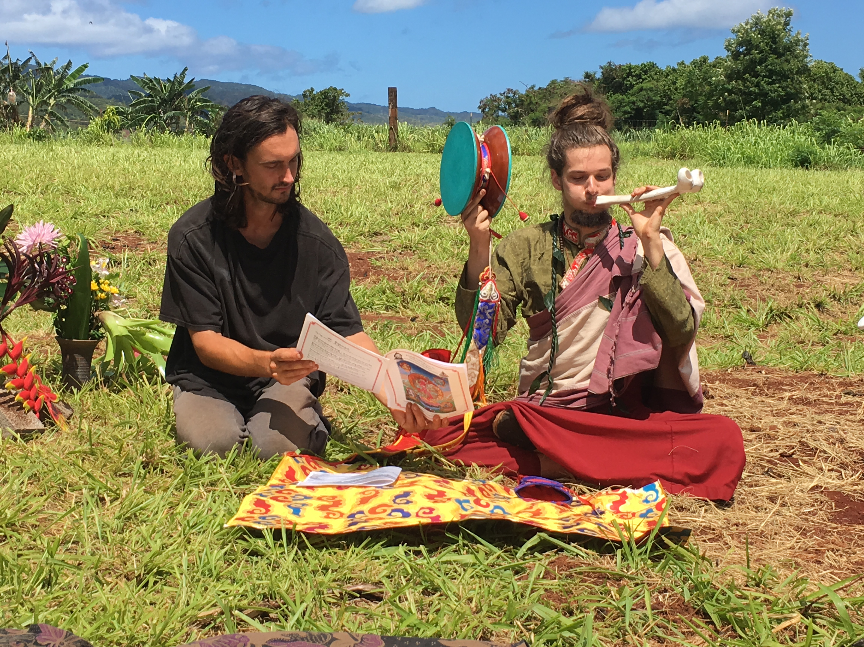
LOGO
Sakyadhita Hawai’i
LOGO
Programs
Interreligious Dialogue
Sustainable Agriculture
Intereligious Celebration
Notes:
Home page.

Slide 5

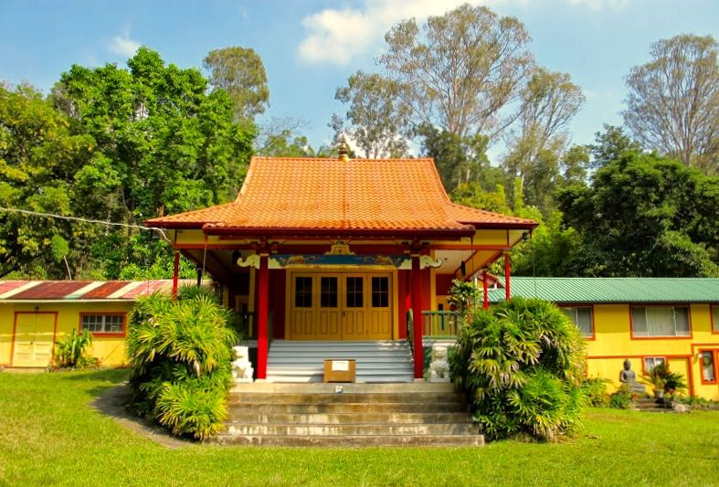
LOGO
Sakyadhita Hawai’i
LOGO
Events
Notes:
Home page.

Slide 6
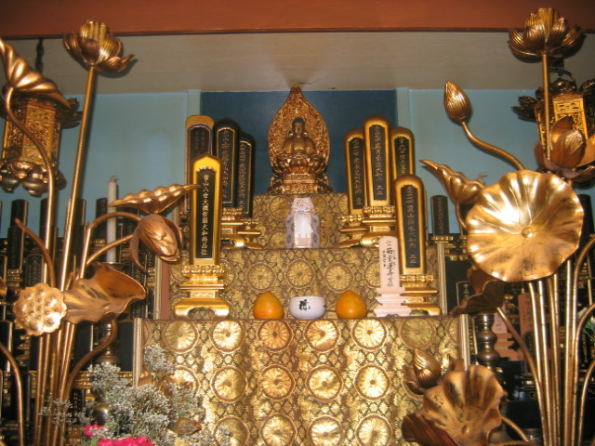
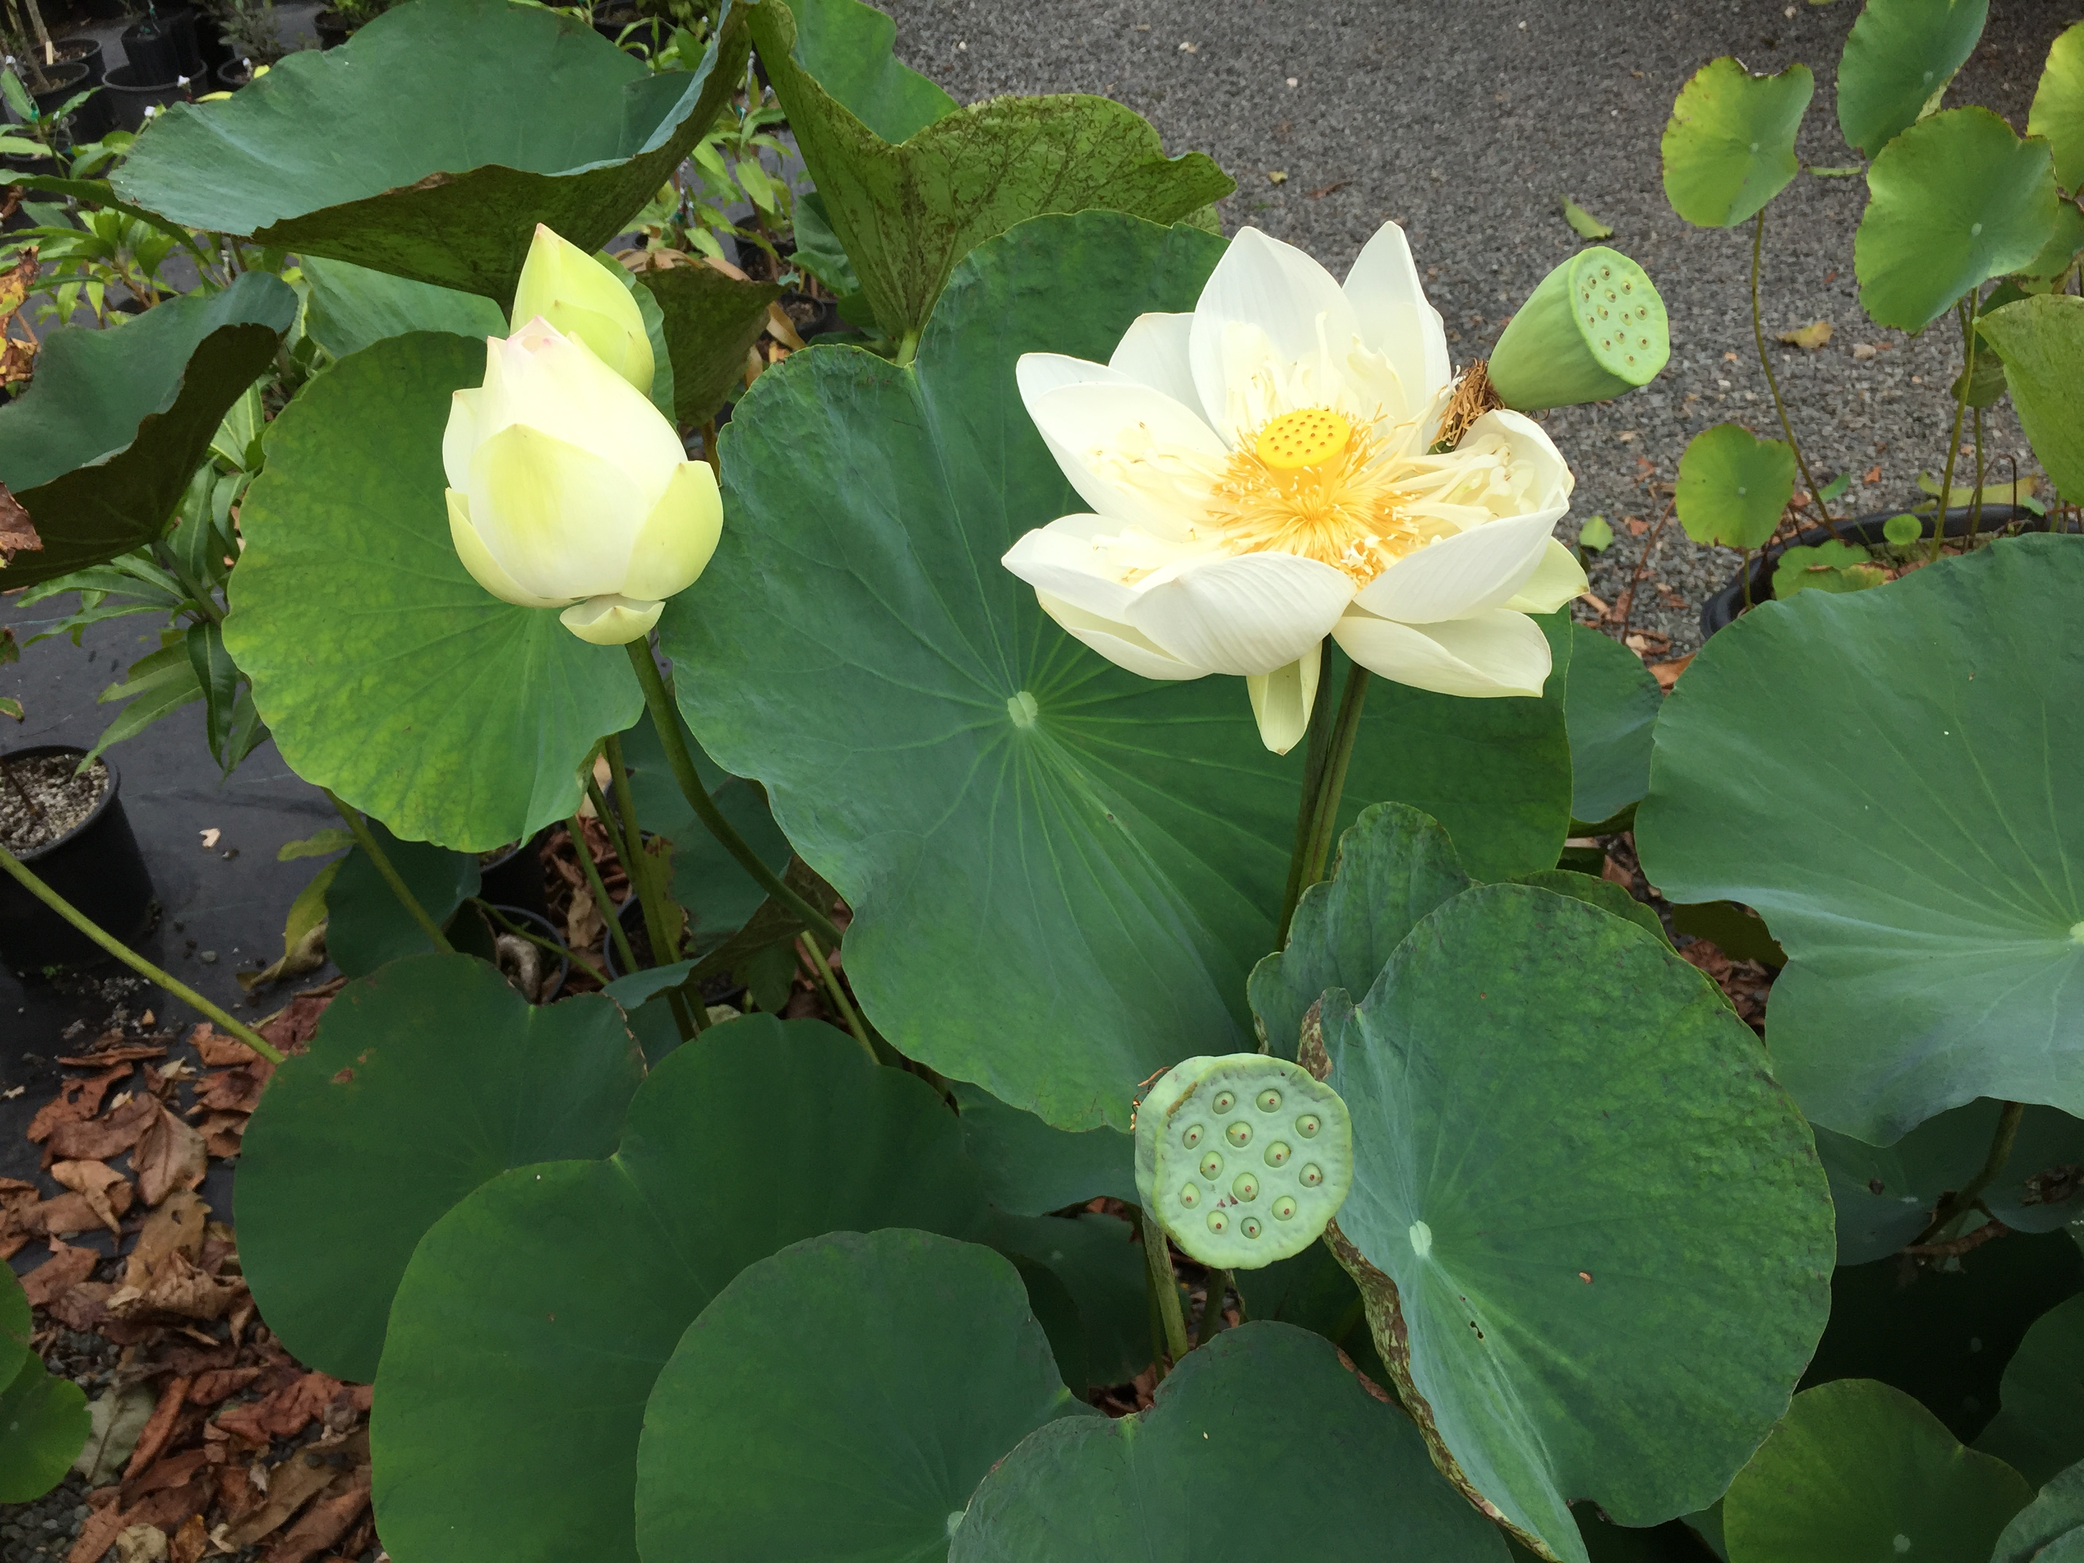
LOGO
Sakyadhita Hawai’i
LOGO
Support Our Work
Notes:
Home page.

Slide 7
LOGO
Sakyadhita Hawai’i
LOGO
Contact
Notes:
Home page.

